Slide 1

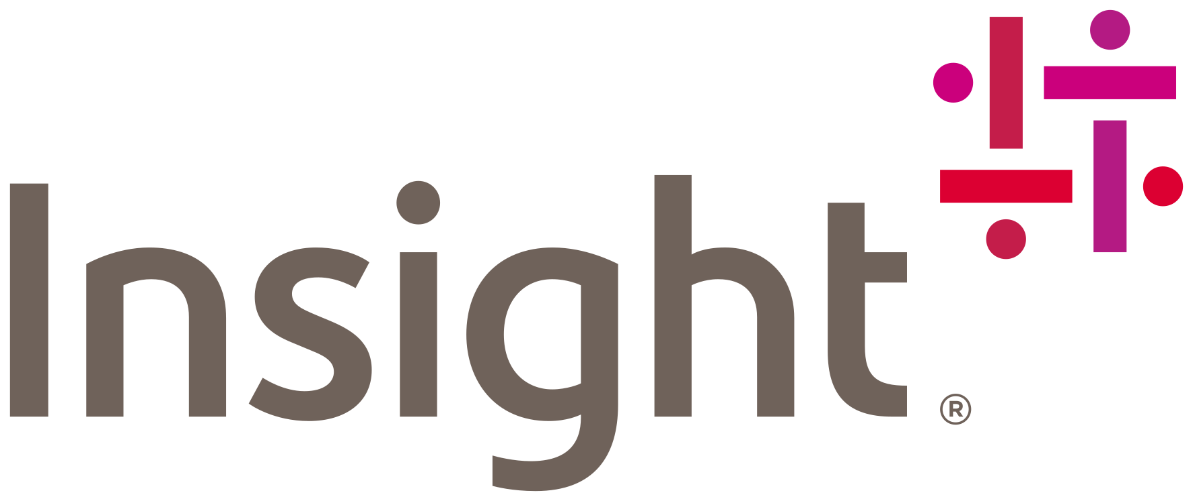
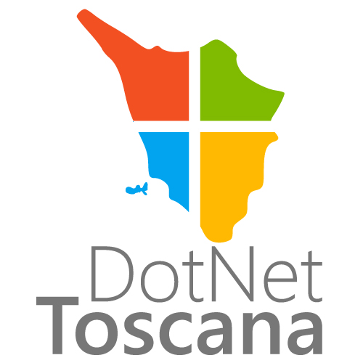
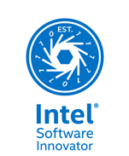

Cloud Modernization with Microsoft Azure
Riccardo Cappello
Senior Consultant @
Microsoft Azure MVP | Intel Software Innovator | rcappello@outlook.com
Notes:
Hello, my name is NAME and I work in TITLE.
Today I would like to talk about our Application Modernization story which is all about how Microsoft Azure can help you take your applications to the next level by moving them to the cloud.
I’ll start by quickly summarizing what challenges we are looking to address when it comes to your application portfolio and then dive deeper into our Application Modernization solution.

Slide 2
Introduction & Challenges

Slide 3
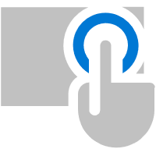

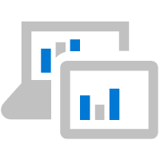
Business is powered by applications
External-facing Applications
Line of Business Applications
DATA
Internal Applications
Notes:
Every modern business is powered by applications.
That is why you can hear people say that every company is a software company.
Every company runs many different applications that are essential for their business – internal business applications (data entry, business intelligence, procurement, legal, CRM, ERP) but also external-facing applications for customers and partners (company web site, customer self-service portal, e-commerce sites, mobile apps for products and services).
Both external-facing applications and internal business applications in turn are connected to and access line of business applications – those mission-critical business systems that form the bedrock of every company – SAP, CRM, mainframe systems that run factories or fulfillment centers, HR, payroll and so on.
And then, there's data.
Every single application in an organization works with data, consumes data and – in turn - generates data.
Today, every business collects tremendous amounts of data - and the challenge is how to turn this treasure trove of unstructured information into actionable insights and intelligence.

Slide 4



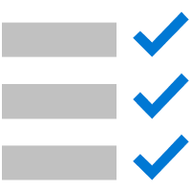




Software or hardware refresh
Address security
threats
Urgent capacity needs
Compliance
Deliver applications and features faster
Enable new business opportunities
Modernization triggers
Datacenter contracts expiring
Software end of support
Notes:
There are quite a few triggers for application migration and modernization, but it essentially comes down to two main motivations: breathing new life into an existing application or extending a legacy application by adding new functionality.
Migration is the quickest way to unlock the benefits of flexible and scalable cloud infrastructure.
Migration triggers include consolidation of data centers, hardware refresh cycles or a general move away from on-premises systems.
Modernization tends to require more effort but unlocks more advanced cloud capabilities such as increased business agility, global scale and improved resiliency of applications and services.
Modernization triggers include wanting to deliver applications and features faster to users and customers, addressing security issues caused by legacy or outdated code and enabling new business opportunities with innovative applications.

Slide 5



Application layers
Code
Data + Intelligence
Infrastructure
Notes:
At a very high level, applications consist of three layers.
The first layer is the application code – functionality and business logic.
Then, there’s the data that the application consumes and generates – every application works with data, and that data can come from many different sources.
Finally, there’s the physical or virtualized infrastructure the application runs on – servers or virtual machines, networking and so on.
When you are looking to modernize an application, you will need to look at all these layers individually.
However, not all layers need to be treated the same way.
You might, for example, decide to keep your data on-premises for security and governance reasons and move application code and infrastructure to the cloud – a common hybrid scenario that addresses specific requirements in regulated industries.

Slide 6
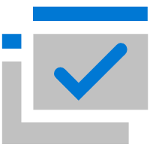
Challenges
Keeping up with the speed of business
Code
More resilient and scalable applications
Adding new features and functionality without taking applications down
Future-proof applications
Data
Application Delivery
Data growth and data silos
Incongruent data types
Performance constraints
Complexity of solutions
Rising data maintenance costs
Security issues and data breaches
Shorter release cycles
Improved software quality
Responding faster to bugs and security incidents
Learning from real usage to continuously improve applications
Infrastructure
Heterogeneous workloads
Hybrid deployments
Security and management
Continuous monitoring
Cost management
Notes:
In many cases, companies already have prior application investments that appear outdated, inflexible or are simply not up to the task because the technology and business environment has changed since they were built.
Many IT budgets are consumed by maintaining existing apps and resources and staying current with upgrades and migrations can deplete funding and resources before business benefits are realized.
If that is the case, such applications need to be re-vitalized and modernized to keep up with the current speed of business.
The growing requirements of our modern, digital business world can be a challenge for older applications – but there is a way to future-proof existing applications.

Slide 7


Are your applications ready?
Today
Future
Application silos, built in isolation
Limited set of platforms and form factors
Overabundance of data
Servers and infrastructure to manage
Upfront capacity planning, fixed scale
Multi-channel applications, covering all touchpoints
Many platforms, devices and form factors
Data-driven intelligence in applications
Focus on application functionality, not infrastructure
Elastic, unlimited scale
Notes:
As the business world moves into the digital space to meet the next generation of customers, employees and partners, create new efficiencies, and compete globally, organizations can’t view applications the same way as before – they must take them to the next level.
Are your applications ready for this new tomorrow?

Slide 8
Modernization strategy: Your application portfolio
Notes:
Application Portfolio Modernization is the process of understanding the current set of applications, data assets and their relationship to a company’s business functions.
The goal is to determine where the current suite of applications fits in the long-term strategy and how well it supports evolving business models.
If approached correctly, portfolio modernization is not a big bang effort that replaces the entire suite of applications with new software.
It’s tempting to begin moving individual applications to the cloud immediately – and cloud vendors make it easy to get started with semi-automated migration and modernization tools.
However, with the right approach, it is possible to modernize a portfolio of applications in a way that yields value quicker and at lower cost - making it easier and less expensive to stay current as products and technologies continue to evolve.

Slide 9
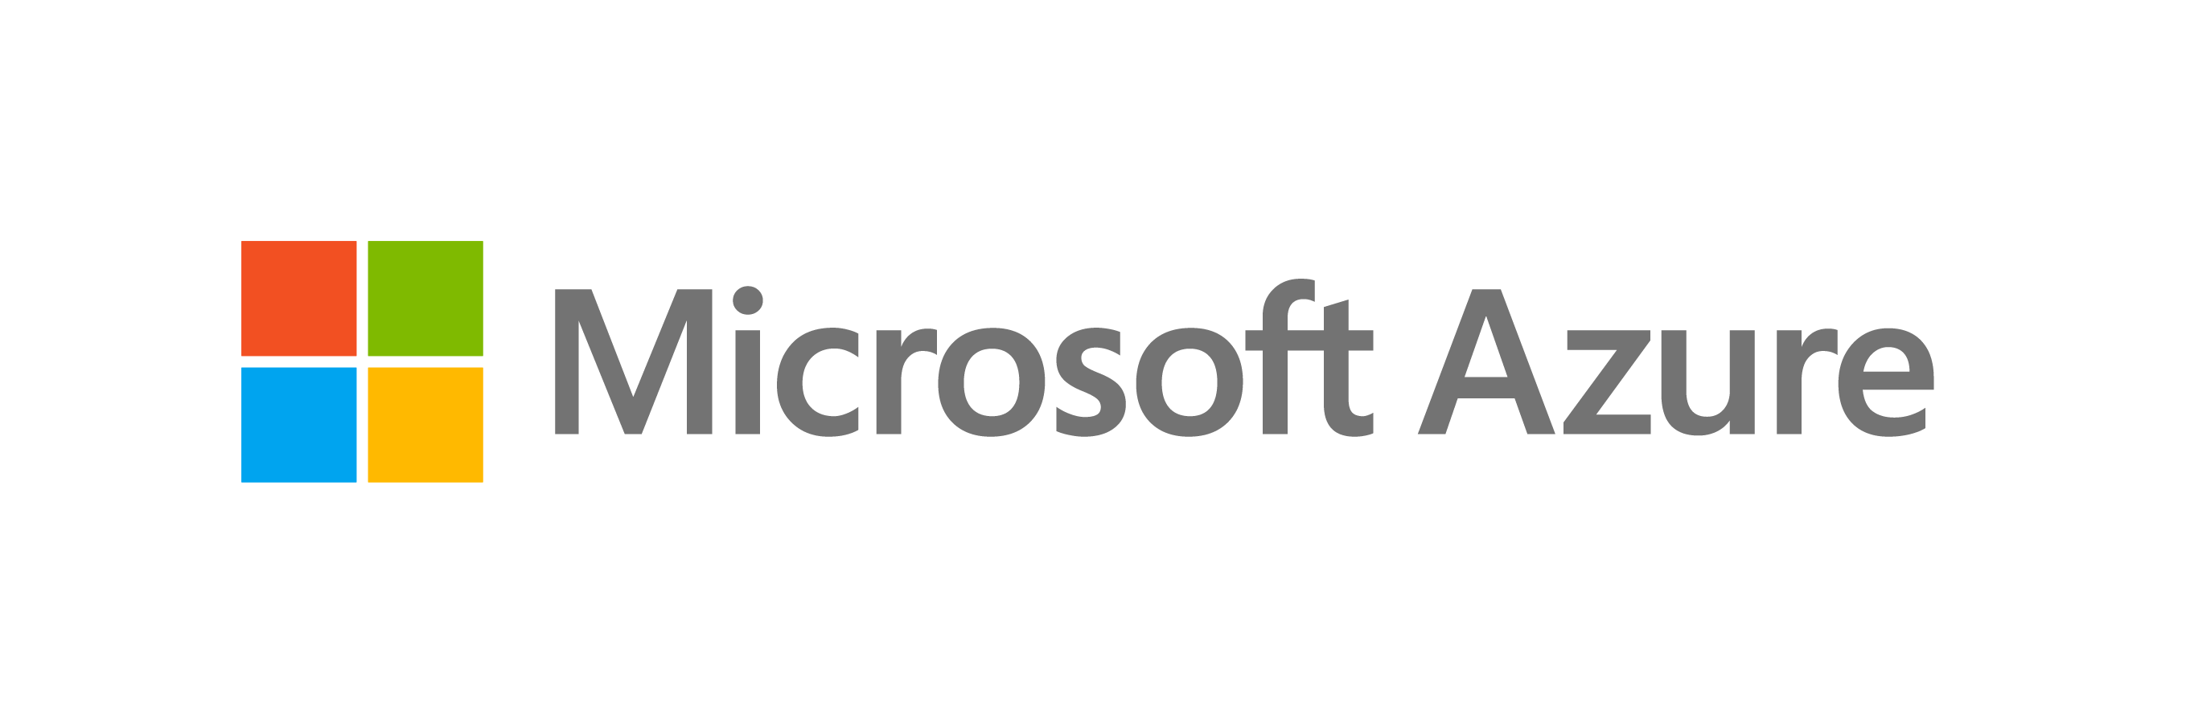
Application portfolio assessment
Creating a migration and modernization roadmap
Plan
Execute
Assess
Prioritize
Business
Business functions
Dependencies
Technology
Infrastructure
Technologies
Data Estate
People
Skills & knowledge
Ability to execute
Business Value
Ability to support business function
Ability to support current technology
Exposure/risk level
Technology maturity and ‘brittleness’
Cost
Cost to maintain
Cost to secure
Cost to update
Application
Flowcharts
Architecture
Data models
Business rules
Code complexity & documentation
Platform
Application infrastructure
Technology stack
Hybrid components
Maintenance and
update workflows
Retire
Replace
Migrate
Modernize
Rebuild
New
Application Portfolio assessment
Notes:
Portfolio modernization is a longer-term project that should be broken into phases based on business impact.
The current set of assets were built or acquired over a long period of time.
In most cases, there was not a defined long-term plan and architecture for an organization’s application portfolio.
An Application Portfolio Assessment helps an organization better understand its existing application environment.
The key focus of the assessment is an understanding of an application's business value and technical characteristics.
These two dimensions will help define both the modernization technique to be used and the potential value to the business associated with the change.

Slide 10
Migration + Modernization
Notes:
What differentiates Microsoft from other cloud vendors is that we meet our customers where they are on their cloud journey,
Whichever path and option you choose, we will be there to ensure you get the best outcome – across IaaS, PaaS, SaaS and even on-premises and any combination thereof.
We are the only cloud vendor that offers this broad set of capabilities.

Slide 11
The journey to the cloud
Infrastructure
Data
Code
“What your application runs on”
“What your application works with”
“What your application does”
Migrate • Innovate
Unified Management • Security • Governance • Tools • DevOps
Notes:
Cloud is the destination, but each application can take a radically different path to get to the cloud.
At a very high level, applications consist of three layers.
The first layer is the application code – functionality and business logic.
Then, there’s the data that the application consumes and generates – every application works with data, and that data can come from many different sources.
Finally, there’s the physical or virtualized infrastructure the application runs on – servers or virtual machines, networking and so on.
When you are looking to build or modernize an application, you will need to look at all these layers individually.
However, not all layers need to be treated the same way.
You might, for example, decide to keep your data on-premises for security and governance reasons and move application code and infrastructure to the cloud – a common hybrid scenario that addresses specific requirements in regulated industries.
What makes Azure special is that we meet customers where they are on their cloud journey.
Whichever path and cloud technology they choose, we will be there for them to ensure they get the best outcome – across IaaS, PaaS, SaaS and any combination thereof.

Slide 12
Migration Strategies
Migrate
Optimize
Modernize
Existing On-Prem applications / databases
No application or database changes; servers are migrated
Take advantage of Azure Services and containers with minimal application & database changes
Architected for the cloud
Modernize/refactor/rewrite
Notes:
Business units often don’t perceive value in just a simple operating system upgrade. Modernization can also addresses the potential business benefits of transforming applications and infrastructure.

Slide 13
Migration Strategy Cost/Duration
Modernize
Initiatives led by need of productivity and agility improvement
Optimize
Cost
Migrate
Strategic initiatives that are enabling innovation, insights and artificial intelligence
Rapid datacenter exit, mergers and acquisitions, divestitures
Existing On-Prem applications
Duration
Notes:
Microsoft leads with balanced Migration Strategy, depending on the application strategy.

Slide 14
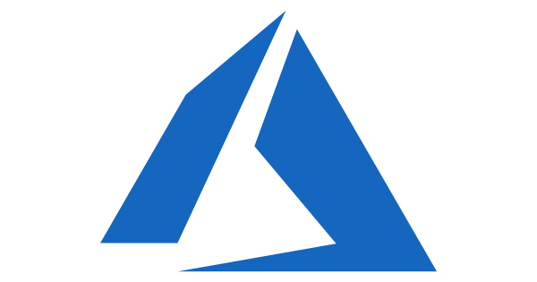
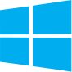

Migrate Migrate your on-premises servers to IaaS
On-Premises
IaaS Cloud (VMs)
Monolithic architecture
Monolithic architecture
Benefits
Migrate
No re-architect or new code
Least effort for quick migration
Supported on the least common denominator
Existing On-Prem applications / databases
Considerations
Same operations as on-prem datacenter for the applications / databases
Rapid Migration requires dedicated high-speed connection
No application or database changes; servers are migrated

Slide 15
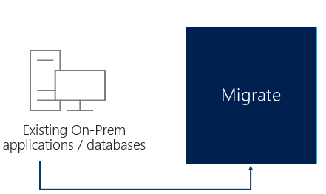
Migrate Migrate your on-premises servers and container images to Azure
Windows Server Migration
Linux Server Migration
Rapid Subnet Migration
Replicate Windows Servers to Azure IaaS with Azure Site Recovery (ASR) *
Replicate Linux Servers to Azure IaaS with Azure Site Recovery (ASR) *
Replicate entire subnet to Azure using Azure Site Recovery with Azure Advanced Networking support for subnet transition to Azure from on-premises.
Rapid VMware Migration
Replicate VMware environments to Azure VMware Solutions (AVS) using native VMware tools** with Azure Advanced Networking support for transition to Azure from on-premises.
* Assumes machines meet requirements for ASR, otherwise a third-party migration tool will be required.
** Assumes source environment on latest VMware versions.
Notes:
These are examples of scenarios where Microsoft Services can help you Migrate.
If you would like to know more about these scenarios, we can engage one of our Architects to discuss these with you in more depth.

Slide 16
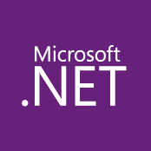
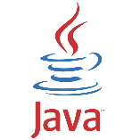
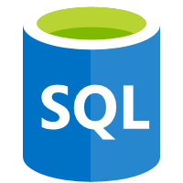
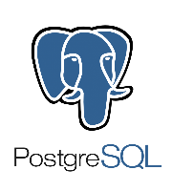
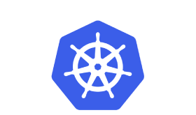
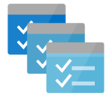
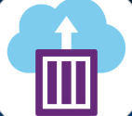
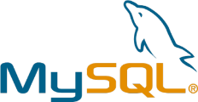
Optimize Get more benefit by optimizing your workloads
On-Premises
Azure Services
Monolithic architecture
Monolithic architecture
Optimize
Benefits
Take advantage of Azure Services – reduce costs with minimal investment
No re-architect or new code
Opportunity for Operating System and Database upgrades
Existing On-Prem applications / databases
Consideration
Some services require modernization in order to be utilized
Take advantage of Azure Services with minimal application & database changes

Slide 17
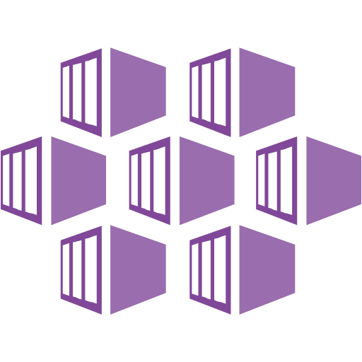
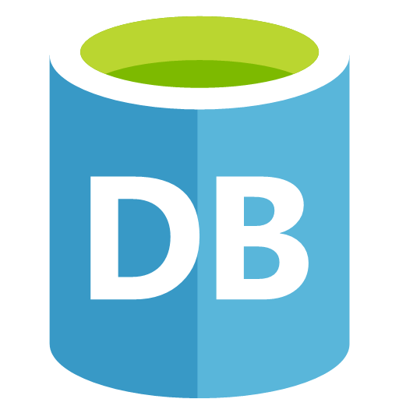
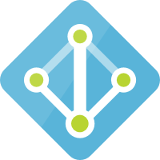
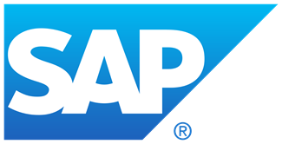
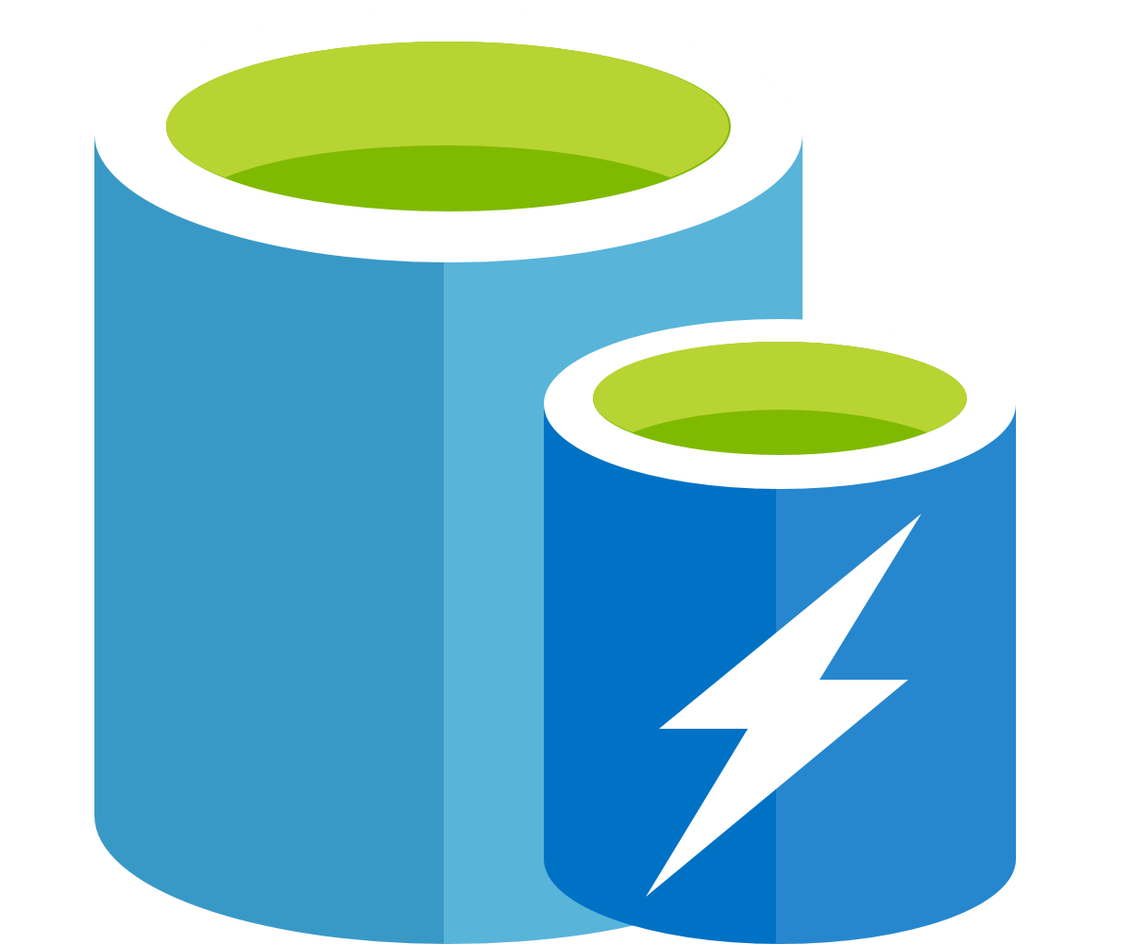

Optimize (Examples) Get more benefit by optimizing your workloads
Workload Migration
Workload Migration with OS Upgrade
Workload Migration to Containers
Rehost workloads to Modern Windows and Linux Servers in Azure IaaS
Rehost workloads running on Legacy Windows, Linux, and Unix servers to a Modern Operating System platform in Azure IaaS
Convert applications to a Container image and enable deployment orchestration
Database Migration
Active Directory Server Migration
SAP Redeploy
Rehost database platforms (SQL Server, Oracle, Sybase, etc.) to Azure IaaS or PaaS. Leverage Azure SQL Managed Instance for optimal migration path.
Migrate Windows Servers to a new Active Directory domain
Rehost Modern SAP environments to Azure IaaS
Application Optimization
Application Composition with Containers
Application Integration with Serverless
Revise applications to use Azure PaaS platform services such as Redis Cache, Blog Storage, etc. with minimal configuration change
Extension of application functionality using loosely coupled architecture to include Container-based components
Integration of application with Azure Functions, Logic Apps, or Event Grid services
Notes:
These are examples of scenarios where Microsoft Services can help you Cloud Optimize.
If you would like to know more about these scenarios, we can engage one of our Architects to discuss these with you in more depth.
Security and Identity optimization comes from Foundational work and inherent across these scenarios.

Slide 18

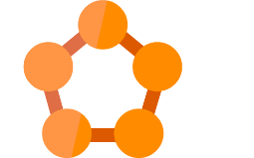

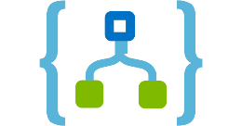
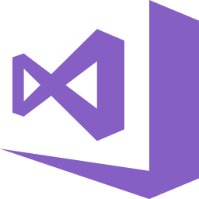
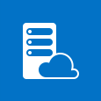
App Modernize Get the most benefit by modernizing your application
On-Premises
Azure Services
Monolithic architecture
Cloud architecture
Benefits
Take most advantage of Azure Services
Code is modified to utilize PaaS services
No Operating System and Database platform maintenance
Optimize for long term agility, scale and high availability
Modernize
Existing On-Prem applications
Considerations
Requires mature code maintenance practices
Azure Service lifecycle changes may require testing and code changes
Architected for the cloud
Modernize/refactor/rewrite

Slide 19
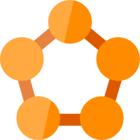

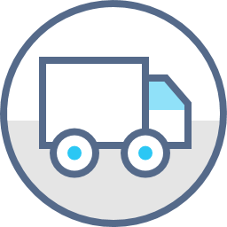




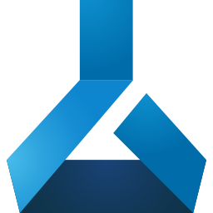
App Modernize (Examples) Get the most benefit by modernizing your application
Application Modernization
Data Modernization for Applications
DevOps
Refactor or revise existing applications to utilize Azure PaaS services
Leveraging advanced Azure data capabilities as part of Application Modernization to evolve beyond N-Tier architectures
Leverage Azure DevOps automation capabilities to streamline Continuous Integration/Continuous Deployment (CI/CD) and Release Management
Security Modernization for Applications
Modern Identity
Azure Native Networking
Leveraging advanced Azure security capabilities as part of Application Modernization for mission critical workloads or industry-specific requirements
Refactoring applications to use Azure Active Directory and other Modern Identity mechanisms
Application Architecture Modernization to include cloud-based ingress including networking security, NVA’s, CDN, etc. to support a global presence
Application Availability Modernization
Telemetry Modernization
Cloud Native Application Modernization
Architecting high availability, deployment orchestration, and disaster recovery for Cloud applications
Modernize monitoring and logging of key application health, performance, security, and business metrics
Rebuild Application to a Cloud Native architecture to utilize advanced Azure services such as AI, Blockchain, IoT, Machine Learning, Bots, etc
Notes:
These are examples of scenarios where Microsoft Services can help you App Modernize.
If you would like to know more about these scenarios, we can engage one of our Architects to discuss these with you in more depth.

Slide 20
Data Modernize Get the most benefit by modernizing your data estate
On-Premises
Azure Data Services
Monolithic architecture
Cloud architecture
Benefits
Benefit from the comprehensive suite of Azure Data Services
Productivity and Performance gains with in-memory technologies and dynamic scalability
Compatible migration without changing your applications
Modernize
Existing On-Prem databases
Considerations
Some manual remediation might be needed based on Data Migration Assistant recommendations
Architected for the cloud
Modernize/refactored/rearchitected

Slide 21


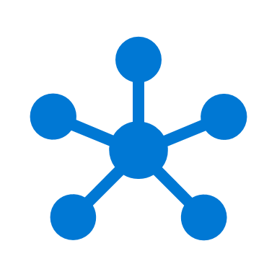

Data Modernize (Examples) Get the most benefit by modernizing your data estate
Database Modernization
Performance at Scale
Mission Critical availability on any platform
Modernize to Azure and leverage options such as Azure SQL Managed instance, Single database, elastic pool based on your workload
In-memory technologies provide real-time business insight with up to 30x improved throughput and latency and up to 100x faster queries and reports.
HA and DR for Linux and Windows. Architecting high availability, deployment orchestration, and disaster recovery for databases
Ready for AI
Data Insights Modernize
Unleash the power of AI by leveraging built in R and Python capabilities
Bring graph data support to your relational data store. Analyze interconnected data and generate deeper insights.
Security Modernization for Databases
Database Management Modernization
Choice of platform and language
Leveraging advanced threat detection capabilities to continuously monitor harmful attempts to access sensitive data.
As a fully-managed service, Microsoft operates SQL Server for you and ensures availability and performance.
Modernize to the platform of your choice: Windows, Linux, docker. Program using the language of choice: T-SQL, Java, C/C++, C#/VB.NET, PHP, Node.js, Python, Ruby
Notes:
These are examples of scenarios where Microsoft Services can help you App Modernize.
If you would like to know more about these scenarios, we can engage one of our Architects to discuss these with you in more depth.
Performance
All TPC Claims as of 1/19/2018. ¹http://www.tpc.org/4081; ²http://www.tpc.org/3331; ³http://www.tpc.org/3326; ⁴http://www.tpc.org/3321; ⁵http://www.tpc.org/4080; ⁶National Institute of Standards and Technology Comprehensive Vulnerability Database

Slide 22
Sample scenario

Slide 23
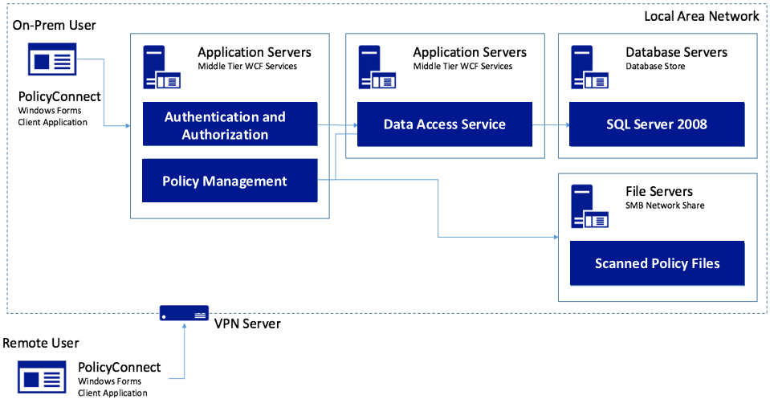
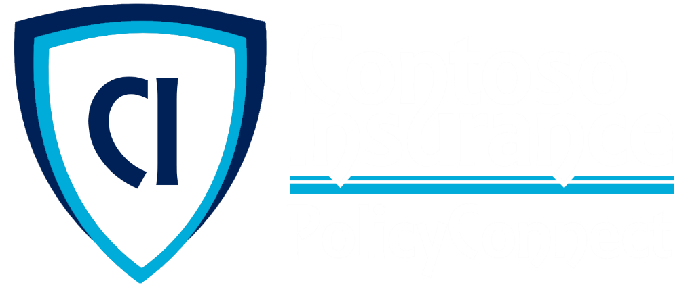
As-Is
Notes:
Contoso Ltd. implemented PolicyConnect, a custom Windows Forms application used by their staff to input key metadata that includes policy holder information such as insured amount, beneficiary, policy type, and any deductible and out of pocket requirements.
Contoso employees access this application which ultimately stores its data in a SQL Server 2008 database, and a file server on their local area network.

Slide 24
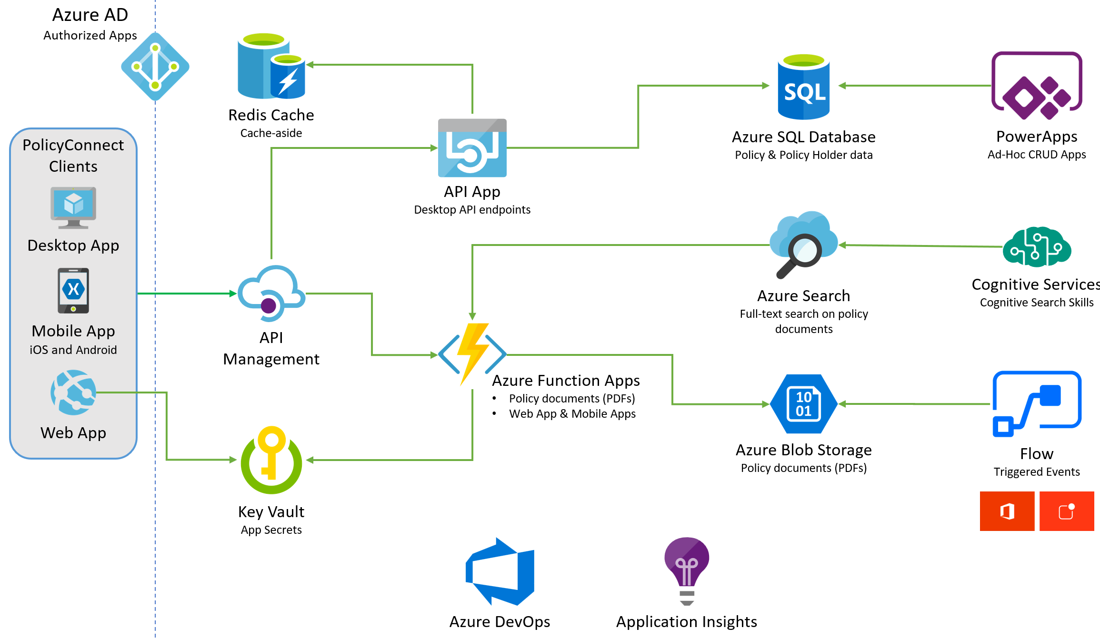
To-Be
Flow / Power Automate
Notes:
The solution begins with migrating Contoso's SQL Server 2008 R2 database to Azure SQL Database using the Azure Database Migration Service. After performing an assessment using the Data Migration Assistant, Contoso was able to determine that there were no compatibility issues or unsupported features to prevent them from migrating into a fully-managed SQL database service in Azure. Next, the web and API apps are migrated into Azure App Services. In addition, mobile apps, built for Android and iOS using Xamarin, are created to provide access to PolicyConnect. The website, hosted in a Web App, provides the user interface for browser-based clients, whereas the Xamarin Forms-based apps provide the UI to mobile devices. Both the mobile app and website rely on web services hosted in an a Function App, which sits behind API Management. An API App is also deployed to host APIs for the legacy Windows Forms desktop application. Light-weight, serverless APIs are provided by Azure Functions and Azure Functions Proxies to provide access to the database and policy documents stored in Blob Storage. Azure API Management is used to create an API Store for development teams and affiliated partners. Sensitive configuration data, like connection strings, are stored in Key Vault and accessed from the APIs or Web App on demand so that these settings never live in their file system. The API App uses the Azure Redis Cache to implement the cache aside pattern, caching data as it is retrieved from SQL Database. A full-text cognitive search pipeline is used to index policy documents in Blob Storage. Cognitive Services are used to enable search index enrichment using cognitive skills in Azure Search. PowerApps enable authorized business users to build mobile and web create, read, update, delete (CRUD) applications that interact with SQL Database and Azure Storage, while Microsoft Flow enables them to orchestrations between services such as Office 365 email and services for sending mobile notifications. These orchestrations can be used independently of PowerApps or invoked by PowerApps to provide additional logic. The solution uses user and application identities maintained in Azure AD.

Slide 25
Thank you!
Riccardo Cappello
Senior Consultant @
Microsoft Azure MVP | Intel Software Innovator | rcappello@outlook.com
Notes:
Hello, my name is NAME and I work in TITLE.
Today I would like to talk about our Application Modernization story which is all about how Microsoft Azure can help you take your applications to the next level by moving them to the cloud.
I’ll start by quickly summarizing what challenges we are looking to address when it comes to your application portfolio and then dive deeper into our Application Modernization solution.

